Slide 1
Thursday, June 11th, 2020
Topic: Windows OS
Objectives:
To Identify important information about the evolution that Windows OS has had throughout the years.
To know about characteristics each Windows OS have.

Slide 2
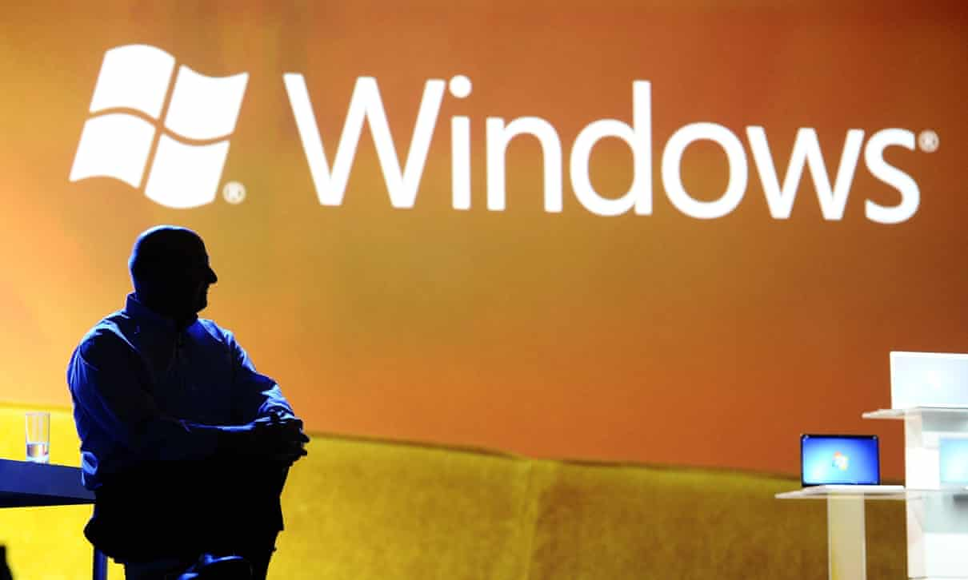

Slide 3
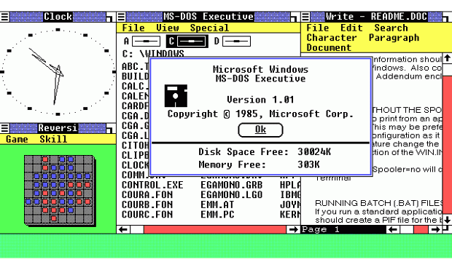
Windows 1
This is where it all started for Windows. The original Windows 1 was released in November 1985 and was Microsoft’s first true attempt at a graphical user interface in 16-bit.
Development was spearheaded by Microsoft founder Bill Gates and ran on top of MS-DOS, which relied on command-line input.
It was notable because it relied heavily on use of a mouse before the mouse was a common computer input device. To help users become familiar with this odd input system, Microsoft included a game, Reversi (visible in the screenshot) that relied on mouse control, not the keyboard, to get people used to moving the mouse around and clicking onscreen elements.

Slide 4
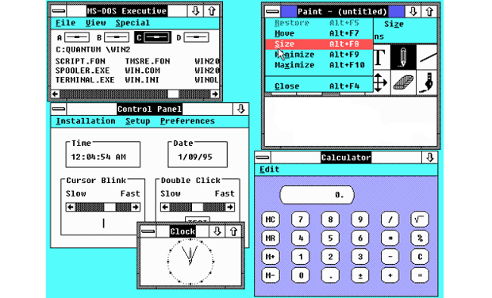
Windows 2
Two years after the release of Windows 1, Microsoft’s Windows 2 replaced it in December 1987. The big innovation for Windows 2 was that windows could overlap each other, and it also introduced the ability to minimise or maximise windows instead of “iconising” or “zooming”.
The control panel, where various system settings and configuration options were collected together in one place, was introduced in Windows 2 and survives to this day.
Microsoft Word and Excel also made their first appearances running on Windows 2.

Slide 5
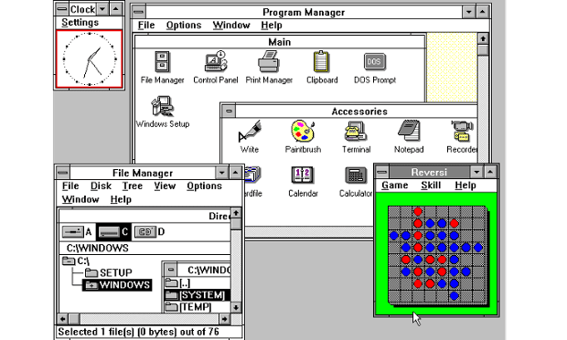
Windows 3
The first Windows that required a hard drive launched in 1990. Windows 3 was the first version to see more widespread success and be considered a challenger to Apple’s Macintosh and the Commodore Amiga graphical user interfaces, coming pre-installed on computers from PC-compatible manufacturers including Zenith Data Systems.
Windows 3 introduced the ability to run MS-DOS programmes in windows, which brought multitasking to legacy programmes, and supported 256 colours bringing a more modern, colourful look to the interface.
Notes:
mayo de 1990 nace windows3.0, existia el soporte de red.

Slide 6
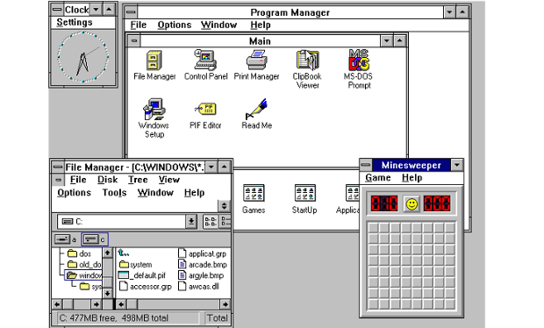
Windows 3.1
Windows 1 and 2 both had point release updates, but Windows 3.1 released in 1992 is notable because it introduced TrueType fonts making Windows a viable publishing platform for the first time.
Minesweeper also made its first appearance. Windows 3.1 required 1MB of RAM to run and allowed supported MS-DOS programs to be controlled with a mouse for the first time. Windows 3.1 was also the first Windows to be distributed on a CD-ROM, although once installed on a hard drive it only took up 10 to 15MB (a CD can typically store up to 700MB).

Slide 7
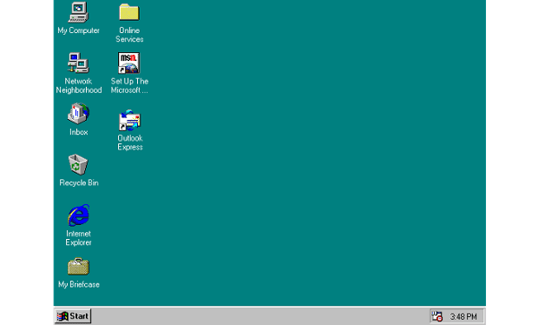
Windows 95
As the name implies, Windows 95 arrived in August 1995 and with it brought the first ever Start button and Start menu.
It also introduced the concept of “plug and play” – connect a peripheral and the operating system finds the appropriate drivers for it and makes it work. That was the idea; it didn’t always work in practice.
Windows 95 also introduced a 32-bit environment, the task bar and focused on multitasking. MS-DOS still played an important role for Windows 95, which required it to run some programmes and elements.
Internet Explorer also made its debut on Windows 95, but was not installed by default requiring the Windows 95 Plus! pack.

Slide 8
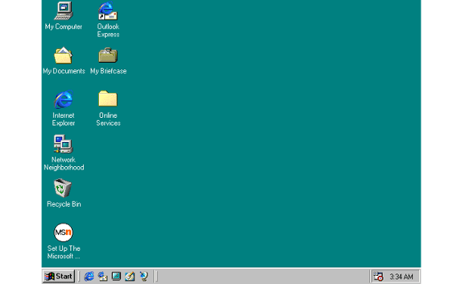
Windows 98
Released in June 1998, Windows 98 built on Windows 95 and brought with it IE 4, Outlook Express, Windows Address Book, Microsoft Chat and NetShow Player, which was replaced by Windows Media Player 6.2 in Windows 98 Second Edition in 1999.
Windows 98 introduced the back and forward navigation buttons and the address bar in Windows Explorer, among other things. One of the biggest changes was the introduction of the Windows Driver Model for computer components and accessories – one driver to support all future versions of Windows.
USB support was much improved in Windows 98 and led to its widespread adoption, including USB hubs and USB mice.

Slide 9
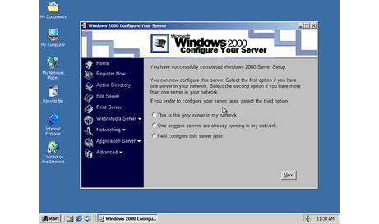
Windows 2000
The enterprise twin of ME, Windows 2000 was released in February 2000 and was based on Microsoft’s business-orientated system Windows NT and later became the basis for Windows XP.
Microsoft’s automatic updating played an important role in Windows 2000 and became the first Windows to support hibernation.

Slide 10
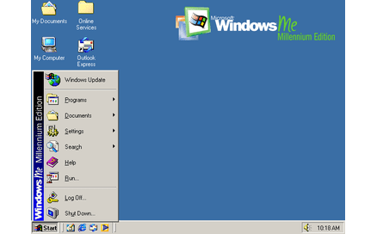
Windows ME
Considered a low point in the Windows series by many – at least, until they saw Windows Vista – Windows Millennium Edition was the last Windows to be based on MS-DOS, and the last in the Windows 9x line.
Released in September 2000, it was the consumer-aimed operating system twined with Windows 2000 aimed at the enterprise market. It introduced some important concepts to consumers, including more automated system recovery tools.
IE 5.5, Windows Media Player 7 and Windows Movie Maker all made their appearance for the first time.

Slide 11
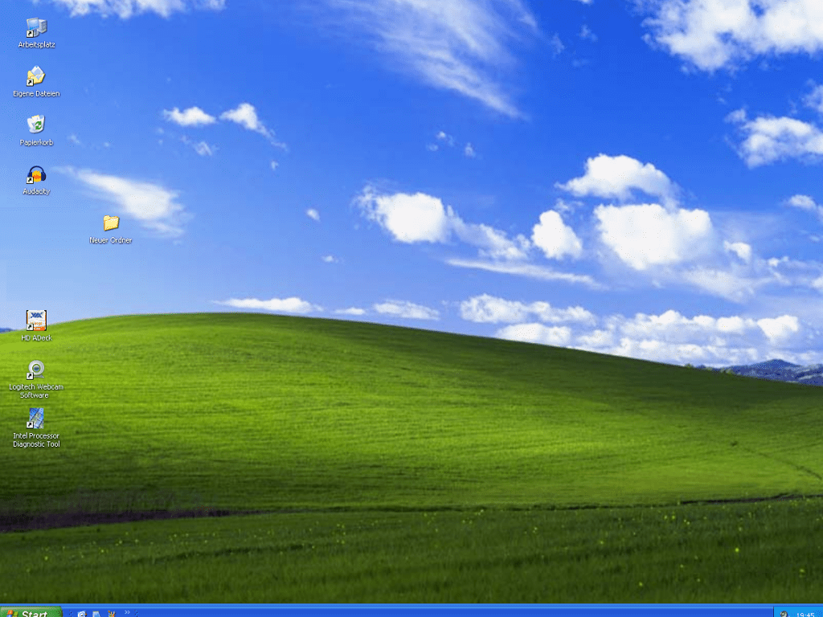
Windows XP
Arguably one of the best Windows versions, Windows XP was released in October 2001 and brought Microsoft’s enterprise line and consumer line of operating systems under one roof.
It was based on Windows NT like Windows 2000, but brought the consumer-friendly elements from Windows ME. The Start menu and task bar got a visual overhaul, bringing the familiar green Start button, blue task bar and vista wallpaper, along with various shadow and other visual effects.
ClearType, which was designed to make text easier to read on LCD screens, was introduced, as were built-in CD burning, autoplay from CDs and other media, plus various automated update and recovery tools, that unlike Windows ME actually worked.
Notes:
25 de octubre 2001

Slide 12
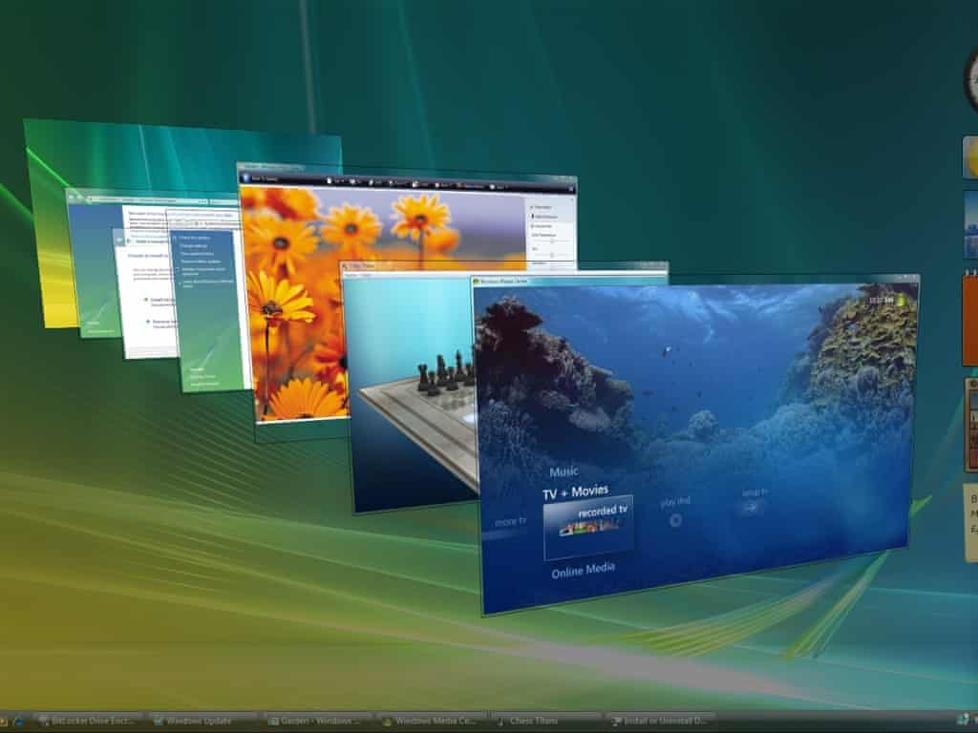
Windows Vista
Windows XP stayed the course for close to six years before being replaced by Windows Vista in January 2007. Vista updated the look and feel of Windows with more focus on transparent elements, search and security. Its development, under the codename “Longhorn”, was troubled, with ambitious elements abandoned in order to get it into production.
PC gamers saw a boost from Vista’s inclusion of Microsoft’s DirectX 10 technology.
Windows Media Player 11 and IE 7 debuted, along with Windows Defender an anti-spyware programme. Vista also included speech recognition, Windows DVD Maker and Photo Gallery, as well as being the first Windows to be distributed on DVD.

Slide 13
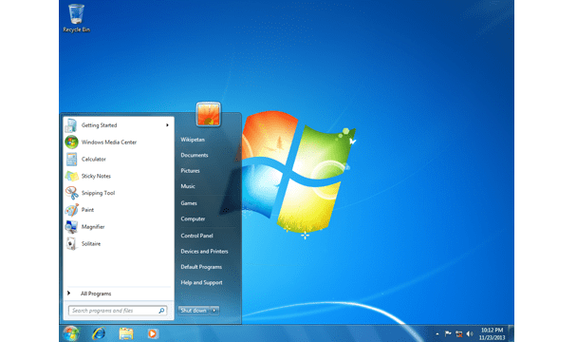
Windows 7
Considered by many as what Windows Vista should have been, Windows 7 was first released in October 2009. It was intended to fix all the problems and criticism faced by Vista, with slight tweaks to its appearance and a concentration on user-friendly features and less “dialogue box overload”.
Advertisement
It was faster, more stable and easier to use, becoming the operating system most users and business would upgrade to from Windows XP, forgoing Vista entirely.
Handwriting recognition debuted in 7, as did the ability to “snap” windows to the tops or sides of the screen, allowing faster more automatic window resizing.
Notes:
20 de julio 2009

Slide 14
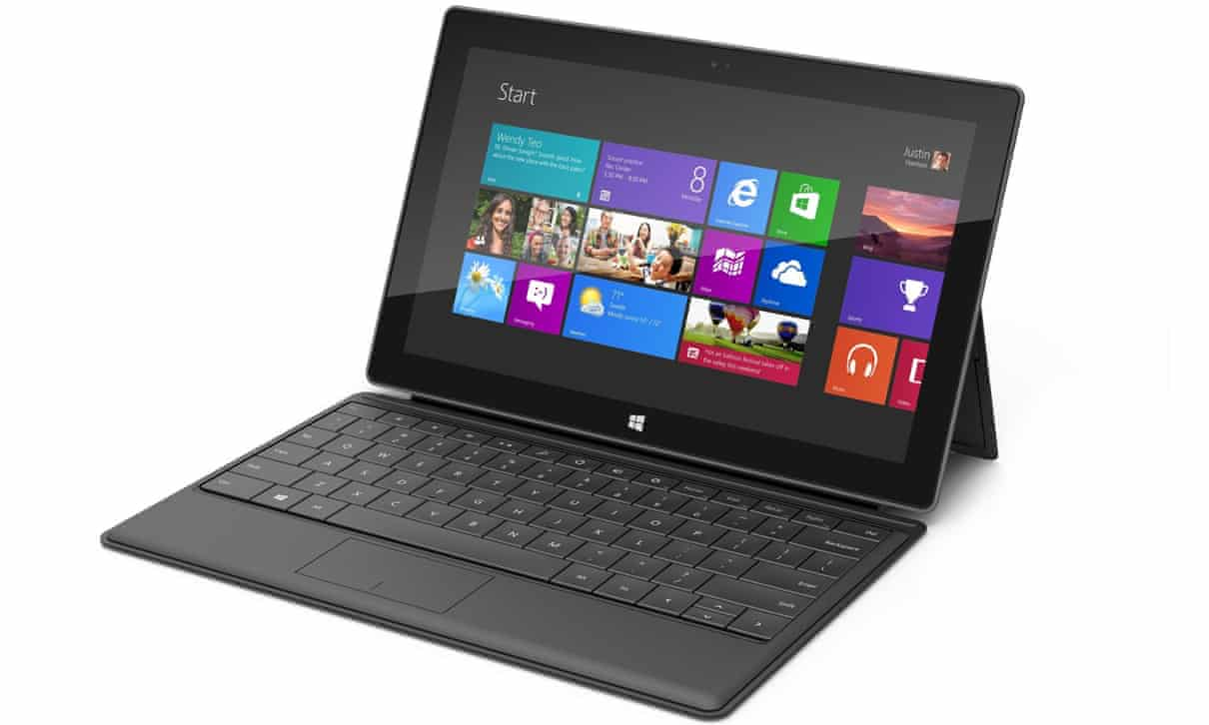
Windows 8
Released in October 2012, Windows 8 was Microsoft’s most radical overhaul of the Windows interface, ditching the Start button and Start menu in favour of a more touch-friendly Start screen.
The new tiled interface saw programme icons and live tiles, which displayed at-a-glance information normally associated with “widgets”, replace the lists of programmes and icons. A desktop was still included, which resembled Windows 7.
Windows 8 was faster than previous versions of Windows and included support for the new, much faster USB 3.0 devices.

Slide 15
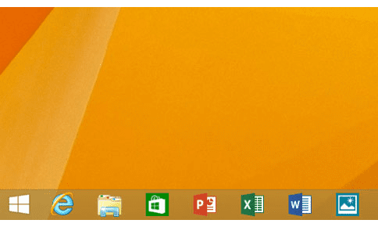
Windows 8.1
A free point release to Windows 8 introduced in October 2013, Windows 8.1 marked a shift towards yearly software updates from Microsoft and included the first step in Microsoft’s U-turn around its new visual interface.
Windows 8.1 re-introduced the Start button, which brought up the Start screen from the desktop view of Windows 8.1. Users could also choose to boot directly into the desktop of Windows 8.1, which was more suitable for those using a desktop computer with a mouse and keyboard than the touch-focused Start screen.

Slide 16
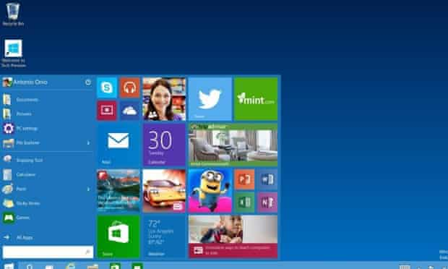
Windows 10
Announced on 30 September 2014, Windows 10 has only been released as a test version for keen users to try. The “technical preview” is very much still a work in progress.
Windows 10 represents another step in Microsoft’s U-turn, bringing back the Start menu and more balance to traditional desktop computer users.
Some interesting features include the ability to switch between a keyboard and mouse mode and a tablet mode, for those computers like the Surface Pro 3 with a detachable keyboard.
Windows 10 – despite being the ninth version of Windows – is designed to unify all Windows platforms across multiple devices, including Windows Phone and tablets, with universal apps that can be downloaded from the Windows Store and run on all Windows devices.

